Slide 1


Personal Umbrella Policy

Slide 2
Is there someone who can help me !
An accident on your swing set causes serious injuries.
A guest has an accident around your pool that requires surgery.
You're burning leaves and cause a fire that damages neighborhood homes.
You accidentally crash your boat into another boat.
Your teen driver accidentally hits a pedestrian.
A broken step causes your babysitter or a guest to have an accident.
Your dog bites someone and you are sued for the damages.
You post a negative online review that results in an alleged defamation lawsuit.

Slide 3
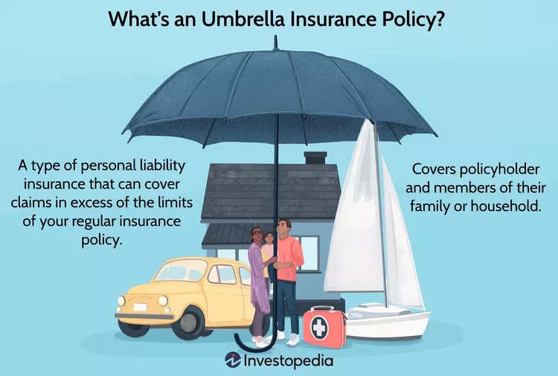
Notes:
Excess and Umbrella Liability Policies
Primary policies (CGL, Auto, Homeowners) provide first layer of protection Excess liability policy provides coverage above limits of primary policies Umbrella policy provides additional limits (as excess does) and may also provide additional coverage over self-insured retention
Umbrella Policy is a broader Liability policy meant to bridge in the gap of your underlying policy or over and above of the exclusions in them. It kicks in when policies limits are exhausted or even when certain losses are uncovered in the basic policy. It works with a SIR- Self Insured Retention
Few examples: Your dog runs out of the house and viciously attacks a neighbor who was going for a walk. Your neighbor sues you to cover her medical bills, lost wages, and pain and suffering.
Your daughter gets into a fight at school and punches another girl, breaking her nose. The girl’s parents sue you.
You cause a 10-car accident and your auto insurance property damage coverage isn’t high enough to replace all 10 accident victims' vehicles. Nor is your personal liability coverage high enough to pay for their medical bills.
You send sandwiches to your son’s school for a field trip lunch. Several students develop food poisoning and their parents sue you.
Your teenager throws a party at your house while you’re out of town. Someone brings alcohol to the party, and one of the guests is arrested for driving under the influence on the way home. You are sued.

Slide 4

https://youtu.be/FMRfWyorCFE?feature=shared
Notes:
Why Is This Coverage Needed?
Problems determining Maximum Possible Loss Layering of liability coverage Primary insurer unwilling to provide high limits Effect of aggregate limits

Slide 5
What does umbrella insurance cover?
Umbrella insurance provides coverage beyond the limits of your other insurance policies, or for claims that may not be covered by liability policies. Umbrella insurance generally provides liability coverage for:
Injuries
Damage to property
Certain lawsuits
Personal liability situations
Who is covered under a personal umbrella policy?
For the liabilities involving:
You and your spouse
Any person named on the Policy Declarations
Any relative or dependent living with you

Slide 6
Examples: Umbrella Insurance Coverages
Owners of rental units help protect against liability that you may face as a landlord. Examples include the cost of liability claims due to:
Someone tripping over a crack in the sidewalk of your rental property and suing you for damages
Your tenant's dog biting someone and you being held responsible for the injuries
Bodily injury liability covers the injuries sustained by another person because of the accident. Examples include the cost of medical bills and/or liability claims due to injuries caused by:
A serious auto accident where you're at fault
Harm caused to others by your dog*
A guest in your home falls
A neighbor's child falls while playing in your yard
Coverage is also provided if you're sued for:
Slander: An injurious spoken statement
Libel: An injurious written statement
False arrest, detention, or imprisonment
Malicious prosecution
Shock/mental anguish
Property damage liability covers the cost of damage or loss to another person's tangible property. Examples include the cost associated with damage to vehicles and other property due to an auto accident where you are at fault.
Notes:
An accident on your swing set causes serious injuries.
A guest has an accident around your pool that requires surgery.
You're burning leaves and cause a fire that damages neighborhood homes.
You accidentally crash your boat into another boat.
Your teen driver accidentally hits a pedestrian.
A broken step causes your babysitter or a guest to have an accident.
Your dog bites someone and you are sued for the damages.
You post a negative online review that results in an alleged defamation lawsuit.

Slide 7
What is not covered by an umbrella policy?
your injuries or damage to your personal property
a criminal or intentional action causing damage to someone else
liability you assume under a contract

Slide 8
How Umbrella Insurance Works
Let’s say that your homeowner's insurance has a personal liability limit of $300,000 with a deductible of $5000 , Covering slip and fall.
You throw a large holiday party, and one of your guests slips and falls on your icy front steps and she decides to sue you.
In court, the jury sides with your party guest and awards her a judgment of $1 million. This judgment is $700,000 higher than your homeowner's insurance liability limit.
But if you have $1 million in umbrella insurance, your umbrella policy will cover the portion of the judgment that your homeowner's insurance doesn’t. However if its not a covered one on the primary/ Underlying Policy a SIR accommodates it.
The umbrella policy will also cover any attorney fees and other expenses related to the lawsuit that weren’t covered by your homeowner's policy. That coverage is in addition to the $1 million.
To be paid $1 million
$295,00 paid out of the underlying policy (300,000 – 5000)
remaining $700,000 of the judgment plus legal expenses
Notes:
Example of How Umbrella Insurance Works
Let’s say that your homeowner's insurance has a personal liability limit of $300,000. You throw a large holiday party, and one of your guests slips and falls on your icy front steps. She ends up with a concussion and some astronomical medical bills and decides to sue you. In court, the jury sides with your party guest and awards her a judgment of $1 million. This judgment is $700,000 higher than your homeowner's insurance liability limit.
Without a personal liability umbrella, you have to pay that $700,000 out of pocket. The money will have to come out of your retirement account, your main source of savings. The loss is devastating and means you’ll have to work 10 additional years, find a higher paying job, or drastically cut back your expenses to replenish your savings and get back on track to be able to retire.
But if you have $1 million in umbrella insurance, your umbrella policy will cover the portion of the judgment that your homeowner's insurance doesn’t, and your retirement savings will remain intact. The umbrella policy will also cover any attorney fees and other expenses related to the lawsuit that weren’t covered by your homeowner's policy. That coverage is in addition to the $1 million.
If you have a $5,000 deductible on your homeowner's insurance, you’ll pay that amount out-of-pocket. Then, your homeowner's policy will pay the next $295,000, which gets you to the $300,000 policy limit. Your umbrella insurance doesn’t have a separate deductible in this case, because the homeowner's policy covered part of the loss. Your umbrella policy pays the remaining $700,000 of the judgment plus legal expenses, so you’re only out-of-pocket $5,000 for the $1 million judgment.
What if you were found liable in a case where your homeowner's or auto insurance didn’t apply? Then you’d pay an umbrella insurance deductible, called self-insured retention, before the umbrella policy kicked in.

Slide 9
UMBRELLA COVERAGE FEATURES
Protection that applies worldwide
Coverage in certain instances for non-owned automobiles or watercraft (and sometimes
chartered aircraft)
Coverage for damage to property of others in the possession or control of an insured
Coverage for liability assumed by the insured under a contract or agreement (oral,
written, express or implied)
Coverage for personal injury hazards such as libel, slander, false arrest, humiliation,
defamation of character, false imprisonment, wrongful eviction, wrongful detention,
malicious prosecution or invasion of privacy
Full payment of defense costs when primary insurance does not apply, unless the
umbrella excludes the loss.

Slide 10
Personal Liability Coverage
Uninsured or Underinsured Motorists coverage
Defense Coverage
EXCESS DEFENSE PROVISION
Supplementary Payments
Notes:
Defense costs are normally covered in addition to the liability limits, not subtracted from the liability limits
EXCESS DEFENSE PROVISION- Many personal umbrella forms stipulate that defense coverage applies, even if the suit is groundless, false, or fraudulent. The policy, however, does not provide a defense for any allegations that are clearly outside the coverage of the policy.
Supplementary payments are payments that are additional to the basic providing of liability insurance coverage. The costs for these payments are often incurred when an insured party is defending a claim investigation.. Supplementary payments are normally defined to include such items as first aid expenses, premiums for appeal and bail bonds, pre- and post-judgment interest, and reasonable travel expenses incurred by the insured at the insurer's request when assisting in the defense of a claim.

Slide 11
Underlying coverages in Umbrella
GEICO Insurance as an Example requires:
A minimum bodily injury limit of $300,000/$300,000 and a
Property damage limit of $100,000 or $250,000/$500,000 and a
Property damage limit of $100,000 on your auto policy to qualify for an umbrella policy.
Homeowners/Renters Personal Liability coverage of $300,000 is also required.

Slide 12
All State Insurance as an example: Minimum coverage needed before you can purchase PUP
Required coverage | Required liability limits
Primary and secondary residence | $300,000 per occurrence
Residential rental property | $300,000 per occurrence
Automobiles and motor homes | Bodily injury $250,000 each person Bodily injury $500,000 each accident Property damage $100,000 each accident or $500,000 combined single limit
Recreational vehicles | Bodily injury $100,000 each person Bodily injury $300,000 each accident Property damage $100,000 each accident or $300,000 combined single limit
Watercraft | Varies by size and type — see policy for complete details
Personal watercraft | Bodily injury $100,000 each person Bodily injury $300,000 each accident Property damage $100,000 each accident or $300,000 combined single limit
Motorcycle | Bodily injury $100,000 each person Bodily injury $300,000 each accident Property damage $100,000 each accident or $300,000 combined single limit

Slide 13
What Doesn't Umbrella Insurance Cover?
Damage that you or a covered member of your household cause on purpose.
Liability incurred in business or professional activities.
Liability you agreed to assume under a contract you signed.
Liability related to war or armed conflicts
Notes:
What Doesn't Umbrella Insurance Cover?
One great thing about umbrella policies is that they provide broad coverage. They cover any incident that the policy does not specifically exclude, unlike some insurance policies, which only cover specifically named incidents. But no insurance policy covers everything. Here are some things your umbrella policy likely won’t cover:
Damage to your own property. Remember, it’s a liability policy, so it will only cover you if you’re held responsible for damage to someone else’s property. Make sure you have enough homeowner's insurance to protect your own property and possessions.
Damage that you or a covered member of your household cause on purpose. If you deliberately pushed your party guest down the stairs, umbrella insurance wouldn’t cover the costs of the lawsuit or judgment (and neither would your homeowner's insurance).
Liability incurred in business or professional activities. You’ll need business liability insurance to cover these incidents.
Liability you agreed to assume under a contract you signed.
Liability related to war or armed conflicts. Good luck finding any type of insurance that covers war-related damage; the financial losses associated with war are too high for insurance companies to cover.
Is Umbrella Insurance a Good Idea?
It could be if you seek greater peace of mind over the possibility of a financial liability that could deplete your financial assets and you don't mind the added cost.
Is Umbrella Insurance Expensive?
Not usually, relatively speaking. For example, a $1 million policy might cost anywhere from $150 to $300 annually. Bear in mind that it covers liability beyond what other policies that you have (homeowners and auto, for example) will cover. Typically, those will need to be at maximum coverage levels before you're issued an umbrella insurance policy.
Where Can I Buy Umbrella Insurance?
You can probably purchase it from the same insurance company that covers your home and auto. You may also be able to buy it from a different insurance company. Be sure to request quotes so that you can consider the most affordable options.
The Bottom Line
Even the most careful person with the best intentions can end up on the hook for a huge financial judgment from a personal liability lawsuit. While you’re unlikely to find yourself in this situation, it can be smart to protect yourself against such a potentially devastating financial loss. Umbrella insurance can help you do that.

Slide 14
Umbrella Insurance Pricing
Premiums vary by company according to various factors such as:
    Personal umbrella limit
    Amount of underlying limits
    Number of insured properties
    Number of vehicles in the household
    Territory
    Optional endorsements.
    Age of drivers
    Driving records
    Uninsured/underinsured motorists' coverage (where available)
    Watercraft—length and horsepower
    Recreational vehicles
    Location of primary residence
    Child care activities
    Business in the home
Notes:
There is no set or standard rating practice for personal umbrella policies, and rates vary considerably. Rating of personal umbrella coverage is difficult because there is often limited loss experience upon which to base an estimate of appropriate insurance cost. The most common approach is to start with a basic charge that covers the exposures not insured by underlying policies and assuming one residence and one personal auto. Charges for any additional exposures are added to this. Companies use from one to four rating territories. Credits are usually allowed for higher underlying limits or for higher retentions. Increased limits factors are low. An insured with a $1 million umbrella can increase coverage to $2 million for a modest additional charge. Often a second million of coverage can be purchased for under $50.00. For most insureds, premiums will generally range from $80 to $225 for the first $1 million layer of umbrella coverage. As the limits on the umbrella policy are increased, the premium for each successive layer decreases.

Slide 15
Umbrella Insurance’s Forms and structure
There are five major components used in most personal umbrella forms.
  Agreement,
  definitions,
  coverages,
  exclusions, and
  conditions
Structure of a Personal Umbrella Policy
A stand-alone form relies exclusively on its own policy terms, conditions, and exclusions, and is normally a longer form.
A following form policy incorporates the terms, conditions, and exclusions of the underlying policies and therefore is usually shorter
Notes:
State-by-state provisions can vary since most jurisdictions regulate personal insurance closely including the personal umbrella policy, and again, producers are cautioned to closely review the policies they sell to determine if they meet the client’s needs.
Some policies separate the coverages into two distinct sections: the liability coverage section and the defense coverage section.
Some insurers place the maintenance-of-underlying insurance provision and the duties-after-a-loss provision in the conditions section, but others have separate sections for each. A provision found in the conditions section of one form may have its own section in another form

Slide 16
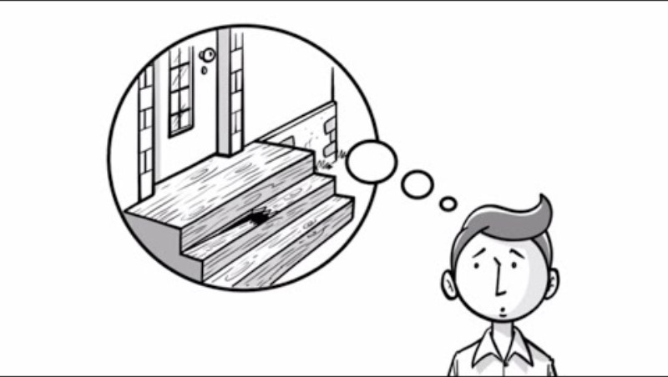
https://youtu.be/GX6X7DHsdAM?si=hsSeWcdWnr8pZYR8

Slide 17
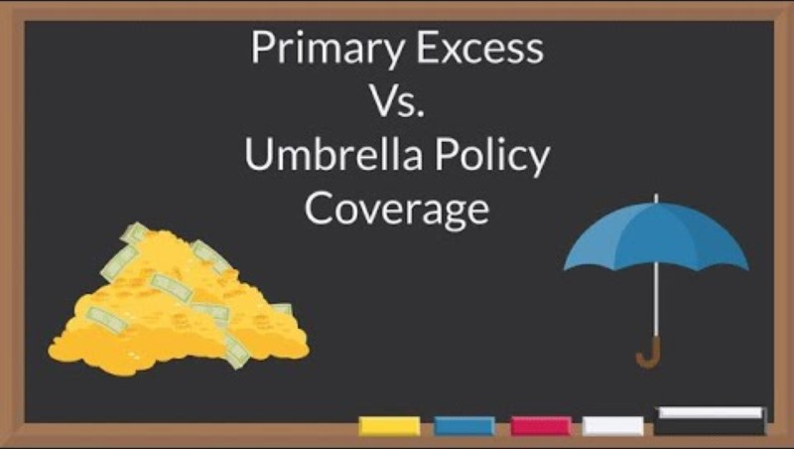
Primary Excess Vs Umbrella Policy Coverage (Liability Insurance)
https://youtu.be/emzk9pSl1Ms?feature=shared
Notes:
Unfortunately, insurers and consumers often use the terms "umbrella" and "excess" interchangeably. An "excess" policy, however, differs from an "umbrella" policy. An excess liability policy provides liability coverage above a specified amount of underlying coverage. The umbrella policy grants broad blanket excess liability coverage and applies to certain exposures not covered by underlying policies. An excess policy does not provide this extra coverage.

Slide 18
PERSONAL UMBRELLA LIABILITY DECLARATIONS PAGE
Each insurance company develops and modifies its own Umbrella Liability Declarations,
however most of these items are found on the Umbrella Liability Declarations include:
  The name and address of the insurer (and company logo)
  Policy number
  Name and mailing address of the insurance agent or agency
  Name and mailing address of the insured
  Policy period including effective and expiration date with month, day and year, as well as
  time of day
  Primary residence address if different from the listed mailing address
  Limits of insurance per accident and the applicable aggregate amount, if any
  Self-insured retention
  Rates for coverages
  List of the forms and endorsements (both mandatory & optional forms) that apply to the
  homeowners policy or coverage section (including edition dates)
  Total umbrella premium
  Schedule of underlying coverages
Notes:
Umbrella declarations generally include a separate page showing the underlying or primary
protection that must be kept in force in order for the excess coverage to apply. The schedule
usually includes the type of coverages required and the minimum limits of insurance accepted.

Slide 19
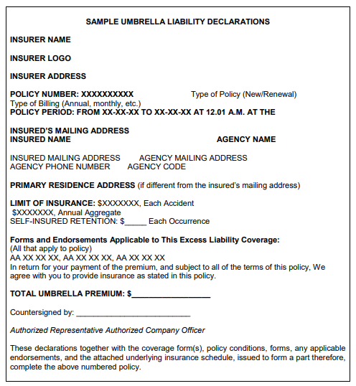

Slide 20
